Slide 1
Training
Ansible, automate server management

Slide 2
Plan
Introduction of the trainer
Objectives of training
The training plan
Public concerned

Slide 3
Introduction of the trainer
Ahmed HOSNI
Technology Manager at Vistaprint.
Devops and cloud native technologies trainer.
Cloud expert for AWS & GCP.
DevOps Institute Ambassador.
keynote speaker.

Slide 4
Training objectives
Understand the organization of Ansible (roles, tasks, playbooks, modules...)
Install and configure Ansible
Use and create playbooks to manage an infrastructure

Slide 5
The training plan
Introduction to Ansible
SSH Secure Tunelling
Ansible Basics
Inventory file
Ad-hoc Orders
Yaml language
Playbook
Variables
Control structures
Tagging: Tags
The roles
Ansible Vault
Lookups
Best practices
6

Slide 6
Relevant audiences
Administrateurs systèmes.
Experts en Redhat.

Slide 7

Let’s start automation ☺

Slide 8
INTRODUCTION TO ANSIBLE

Slide 9
Plan
Introduction
What is Ansible
Principles on configuration management tools
Examples of Ansible
Ansible benefits
Ansible automates any technology
Related to the devops?

Slide 10

Introduction
Michael DeHaan (creator of Cobbler & Func)
Simple AUTOMATES EVERYTHING
Can handle almost any *IX through SSH protocol
Requires Python
Windows (PowerShell, WinRM Python module) Cloud, virtualization, container and network components.
Ansible owes much of its origins to my time in the emerging technologies group at Red Hat, which was an R&D unit under the leadership of Red Hat’s CTO.

Slide 11
What is Ansible
Ansible is an agent-free IT automation tool developed in 2012 by Michael DeHaan, a former Red Hat employee.
The design objectives of Ansible were for him: minimal code, consistent, secure, very reliable and easy to learn.
Ansible was recently acquired by Red Hat.
Ansible works mostly in push mode using SSH.
You can install Ansible on each remote machine, download the playbooks locally and run them on the machines individually if there are a large number of machines (large is a relative term) as more than 500 machines that require updates in parallel.

Slide 12
What is Ansible
Automation of admin tasks:
On a machine park
Deploy applications, configure, manage services
Development:
https://github.com/ansible/ansible
Written in python (users mostly handle YAML) GPLv3.

Slide 13

An ansible is a theoretical device for communication at a superluminal speed. It can send and receive messages to and from the corresponding device over any distance without any delay. The ansibles are an emblematic component of science fiction literature.

Slide 14
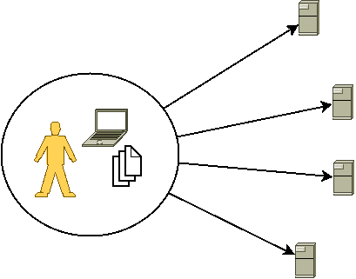
Principles in configuration management tools
“Centralized configuration recipes”, applied on machines (= nodes)
No “hand” config

Slide 15
Principles in configuration management tools
“Centralized configuration recipes”, applied on machines (= nodes)
No “hand” config
Provides high level modules for common manipulations (vs. script shell):
Installation of packages
management of services

Slide 16
Principles in configuration management tools
“Centralized configuration recipes”, applied on machines (= nodes)
No “hand” config
Provides high level modules for common manipulations (vs. script shell):
Installation of packages
management of services
Describes the desired state rather than the steps to get there (vs. shell script):
Idempotence: a recipe results in the same result as it is applied once or several times
Recipes must be written in this way for the state to be stable

Slide 17
ANSIBLE Example - 1
The objective of this software is to maintain an identical configuration on different servers/virtual machines.
Specifically, Ansible enables:
Installation of packages.
Installation of configuration files.
Configuration of services.
Performing all possible administration tasks by ssh.
Coupling with a versioning tool to, for example, track the evolution of the cluster.
Concept of playbooks that defines a set of rules/scripts to be applied/validated.

Slide 18
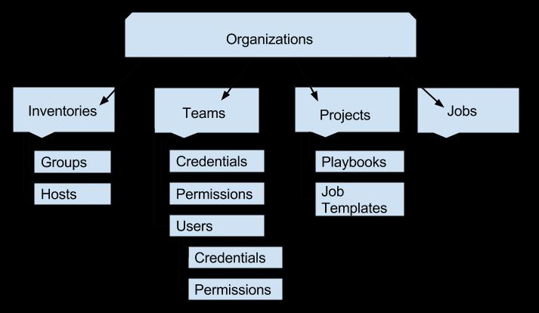
ANSIBLE Example - 2.

Slide 19
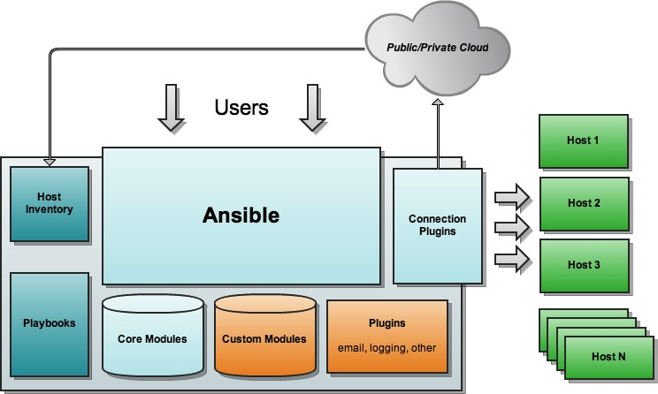
ANSIBLE Example 3.

Slide 20
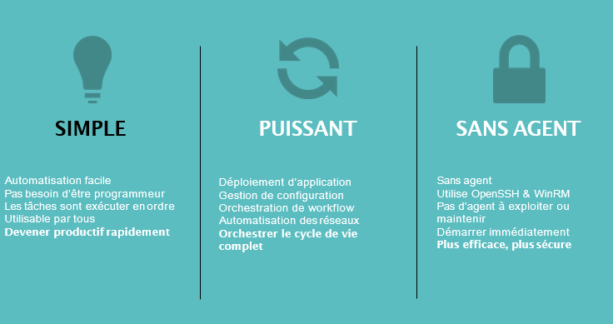
Ansible benefits

Slide 21
Ansible benefits
Why is Ansible popular?
Effective: no agent, minimal installation, desired state (no changes not required), custom delivery technology based architecture, easy fact-based targeting
Fast: Easy to learn/remember, simple declarative language
Scalable: Can handle thousands of nodes, extensible modular architecture
Security: Transport through SSH
Large community: thousands of roles on Ansible Galaxy

Slide 22
Ansible automates any technology
Cloud
Virt & Container
Windows
Network
Security
Monitoring
AWS
Azure
Digital Ocean Google OpenStack Rackspace
+more
Operating Systems RHEL
Linux Windows
+more
Docker VMware RHV
OpenStack OpenShift
+more
ACLs
Files Packages IIS
Regedits Shares Services Configs Users Domains
+more
A10
Arista Aruba Cumulus Bigswitch Cisco Dell Extreme F5
Lenovo MikroTik Juniper OpenSwitch
+more
Checkpoint Cisco CyberArk F5
Fortinet Juniper IBM
Palo Alto Snort
+more
Dynatrace Datadog LogicMonitor New Relic Sensu
+more
Devops Jira GitHub Vagrant Jenkins Slack
+more
Storage
Netapp
Red Hat Storage Infinidat
+more

Slide 23
What’s the connection with the devops?
Centralization of configurations
Infrastructure as a code: The state of an infra described by recipes Teamwork (use of a VCS)
Knowledge sharing:
The devs know the production environment
ops know the changes to be applied to production before an app is deployed.
Automation
Fewer repetitive, manual tasks → Shorten dev. /release/deployment/usage cycles
It becomes easier to instantiate a test platform

Slide 24
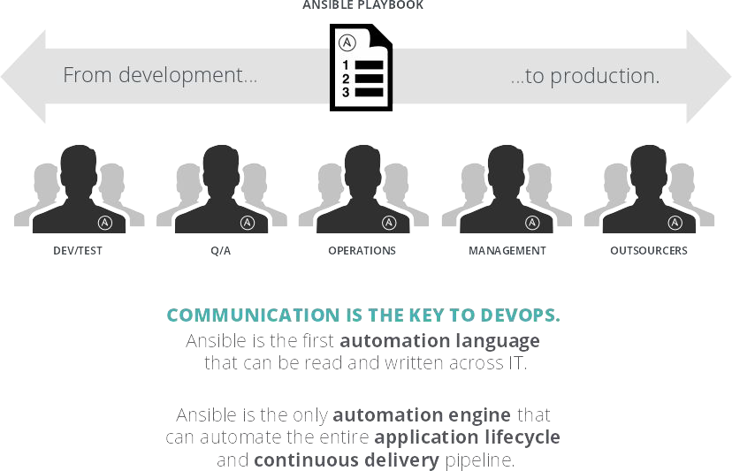
What’s the connection with the devops?

Slide 25
What we have covered
Objectives of Ansible.
Concepts and basics of automation.
Relationship between Ansible and DevOps.

Slide 26
Secure SSH Tunnelling

Slide 27
Plan
Introduction
Client login
Copying of files
Basic server configuration
Understand the role of SSH keys
Managing SSH keys
Saving host keys
Authentication keys

Slide 28
Introduction
Telnet, VNC, X, etc …
In clear
SSH : encryption
OpenSSH

Slide 29

Client connexion
Syntaxe
$ ssh [options] [-F configfile] | [-i identity_file] | [-l | login_name]
[-p port] [user@]hostname | [command]
Exemple
$ ssh admin1@linuxserver
Configuration :
/etc/ssh/ssh-config
/.ssh/config

Slide 30

Copying files
Syntax
$ scp mylocalfile user@server:remotefile
$ scp user@server:remotefile mylocalfile
Example
$ scp archive.tar.gz bernard@192.168.1.1:mesarchives/archive.tar.gz
For more complex tasks: sftp

Slide 31

Basic server configuration
/etc/ssh/sshd-config
Port 22
Protocol 2,1
ListenAddress 0.0.0.0 KeepAlive Yes
HostKey ssh_host_dsa.key HostKey ssh_host_rsa.key PermitRootLogin no PasswordAuthentication yes PubkeyAuthentication yes PermitEmptyPasswords no X11Forwarding yes

Slide 32
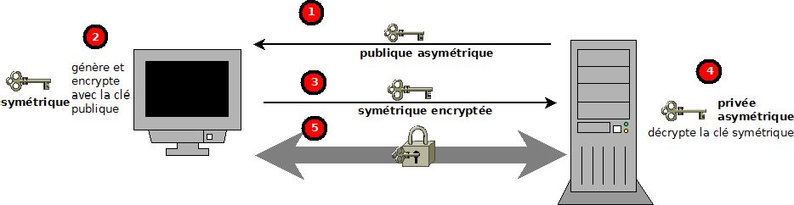
Understand the role of SSH keys

Slide 33

Managing SSH keys
/etc/ssh/ssh_host_rsa_key et /etc/ssh/ssh_host_dsa_key
.pub extension for public
•
générer
# | ssh-keygen | -q | -t | rsa1 -f /etc/ssh/ssh_host_key -C | ‘’ | -N | ‘’
# | ssh-keygen | -q | -t | rsa -f /etc/ssh/ssh_host_rsa_key | -C | ‘’ | -N ‘’
# | ssh-keygen | -q | -t | dsa -f /etc/ssh/ssh_host_dsa_key | -C | ‘’ | -N ‘’

Slide 34
Recording host keys
Lors d’une première authentification
message
~/. ssh/known_hosts
/etc/ssh_known_hosts or /etc/ssh/ssh_known_host

Slide 35
Authentication keys
key generation
client$ ssh-keygen -q -t rsa -f ~/.ssh/id_rsa -C ‘’ -N ‘’
Transfer the public key to the server and add as an authorized client
server access (by password)
client$ ssh compte@serveur
serveur$ ssh-copy-id compte@client

Slide 36
What we have covered
Using and configuring an OpenSSH client 2.
ssh , ssh-keygen , ssh-agent , ssh-add
Understand the role of ssh keys.
/etc/ssh/ssh_host_rsa_key and ssh_host_rsa_key.pub
/etc/ssh/ssh_host_dsa_key and ssh_host_dsa_key.pub
/etc/ssh_known_hosts
~/. ssh/id_rsa and id_rsa.pub ~/. ssh/id_dsa and id_dsa.pub

Slide 37
Basics of ansible

Slide 38
Plan
Introduction
Ansible’s vocabulary
Ansible automation mechanism
Other automation tools
Installing Ansible on the server
Configuration of Ansible
Ansible tools
The different Ansible offers
The modules
The frequent modules
Documentation of modules
Principle of idempotence

Slide 39
Introduction
How does Ansible automate?
What are the basic components of Ansible?
How to install and configure it?

Slide 40
Ansible’s vocabulary
Inventories
Modules
Variables
Facts
Playbooks and plays
Configuration files
Templates
Handlers
Roles
Ansible Vault

Slide 41










Ansible’s vocabulary
PUBLIC / PRIVATE CLOUD
PUBLIC / PRIVATE CLOUD
CMDB
ANSIBLE AUTOMATION ENGINE
USERS
INVENTORY
CLI
HOSTS
MODULES
PLUGINS
NETWORK DEVICES
ANSIBLE PLAYBOOK

Slide 42







Ansible’s vocabulary
PUBLIC / PRIVATE CLOUD
PUBLIC / PRIVATE CLOUD
CMDB
ANSIBLE AUTOMATION ENGINE
PLAYBOOKS written in YAML
USERS
Tasks executed sequentially
Invokes ansible modules
HOSTS
INVENTORY
CLI
MODULES
PLUGINS
NETWORK DEVICES
ANSIBLE PLAYBOOK

Slide 43

PUBLIC / PRIVATE CLOUD
PUBLIC / PRIVATE CLOUD
CMDB
Modules are Ansible “libraries”
ANSIBLE AU_{M}T_{O}OM_{D}A_{U}T_{L}IO_{E}N_{S}E_{A}NG_{R}IN_{E}E_{“TOOL}
Python, Powershell and any other language
Extends the simplicity and power of Ansible
USERS
INVENTORY
CLI
HOSTS
MODULES
PLUGINS
NETWORK DEVICES
ANSIBLE PLAYBOOK
- name: copie index.html
copy:
src: files/index.html
dest: /var/www/html/

Slide 44
Ansible’s vocabulary
PUBLIC / PRIVATE CLOUD
PUBLIC / PRIVATE CLOUD
CMDB
PLUGINS are the gears
- Code that connects to the main engine
- Adaptability to various platforms
USERS
INVENTORY
CLI
HOSTS
MODULES
PLUGINS
NETWORK DEVICES
ANSIBLE PLAYBOOK
{{ some_variable | to_nice_yaml }}

Slide 45
Ansible’s vocabulary
PUBLIC / PRIVATE CLOUD
PUBLIC / PRIVATE CLOUD
CMDB
INVENTORY
List of systems to automate in your infrastructure.
[web] webserver1.example.com webserver2.example.com
[db] dbserver1.example.com
[switches] leaf01.internal.com leaf02.internal.com
[firewalls] checkpoint01.internal.com
[lb]
f5-01.internal.com
ANSIBLE AUTOMATION ENGINE
USERS
ANSIBLE PLAYBOOK
INVENTORY
CLI
HOSTS
MODULES
PLUGINS
NETWORK DEVICES

Slide 46

Ansible’s vocabulary
PUBLIC / PRIVATE CLOUD
PUBLIC / PRIVATE CLOUD
CMDB
ANSIBLE AUTOMATION ENGINE
USERS
HOSTS
MODULES
PLUGINS
NETWORK DEVICES
ANSIBLE PLAYBOOK

Slide 47

Ansible’s vocabulary
PUBLIC / PRIVATE CLOUD
PUBLIC / PRIVATE CLOUD
CMDB
ANSIBLE AUTOMATION ENGINE
USERS
CMDB
ServiceNow, Cob
bler, BM_{H}C_{O},_{S}C_{TS}ustom cmdb
INVENTORY
MODULES
PLUGINS
NETWORK DEVICES
ANSIBLE PLAYBOOK

Slide 48

Ansible’s vocabulary
PUBLIC / PRIVATE CLOUD
PUBLIC / PRIVATE CLOUD
CMDB
ANSIBLE AUTOMATION ENGINE
USERS
INVENTORY
CLI
HOSTS
PLUGINS
NETWORK DEVICES
PLAYBOOK

Slide 49
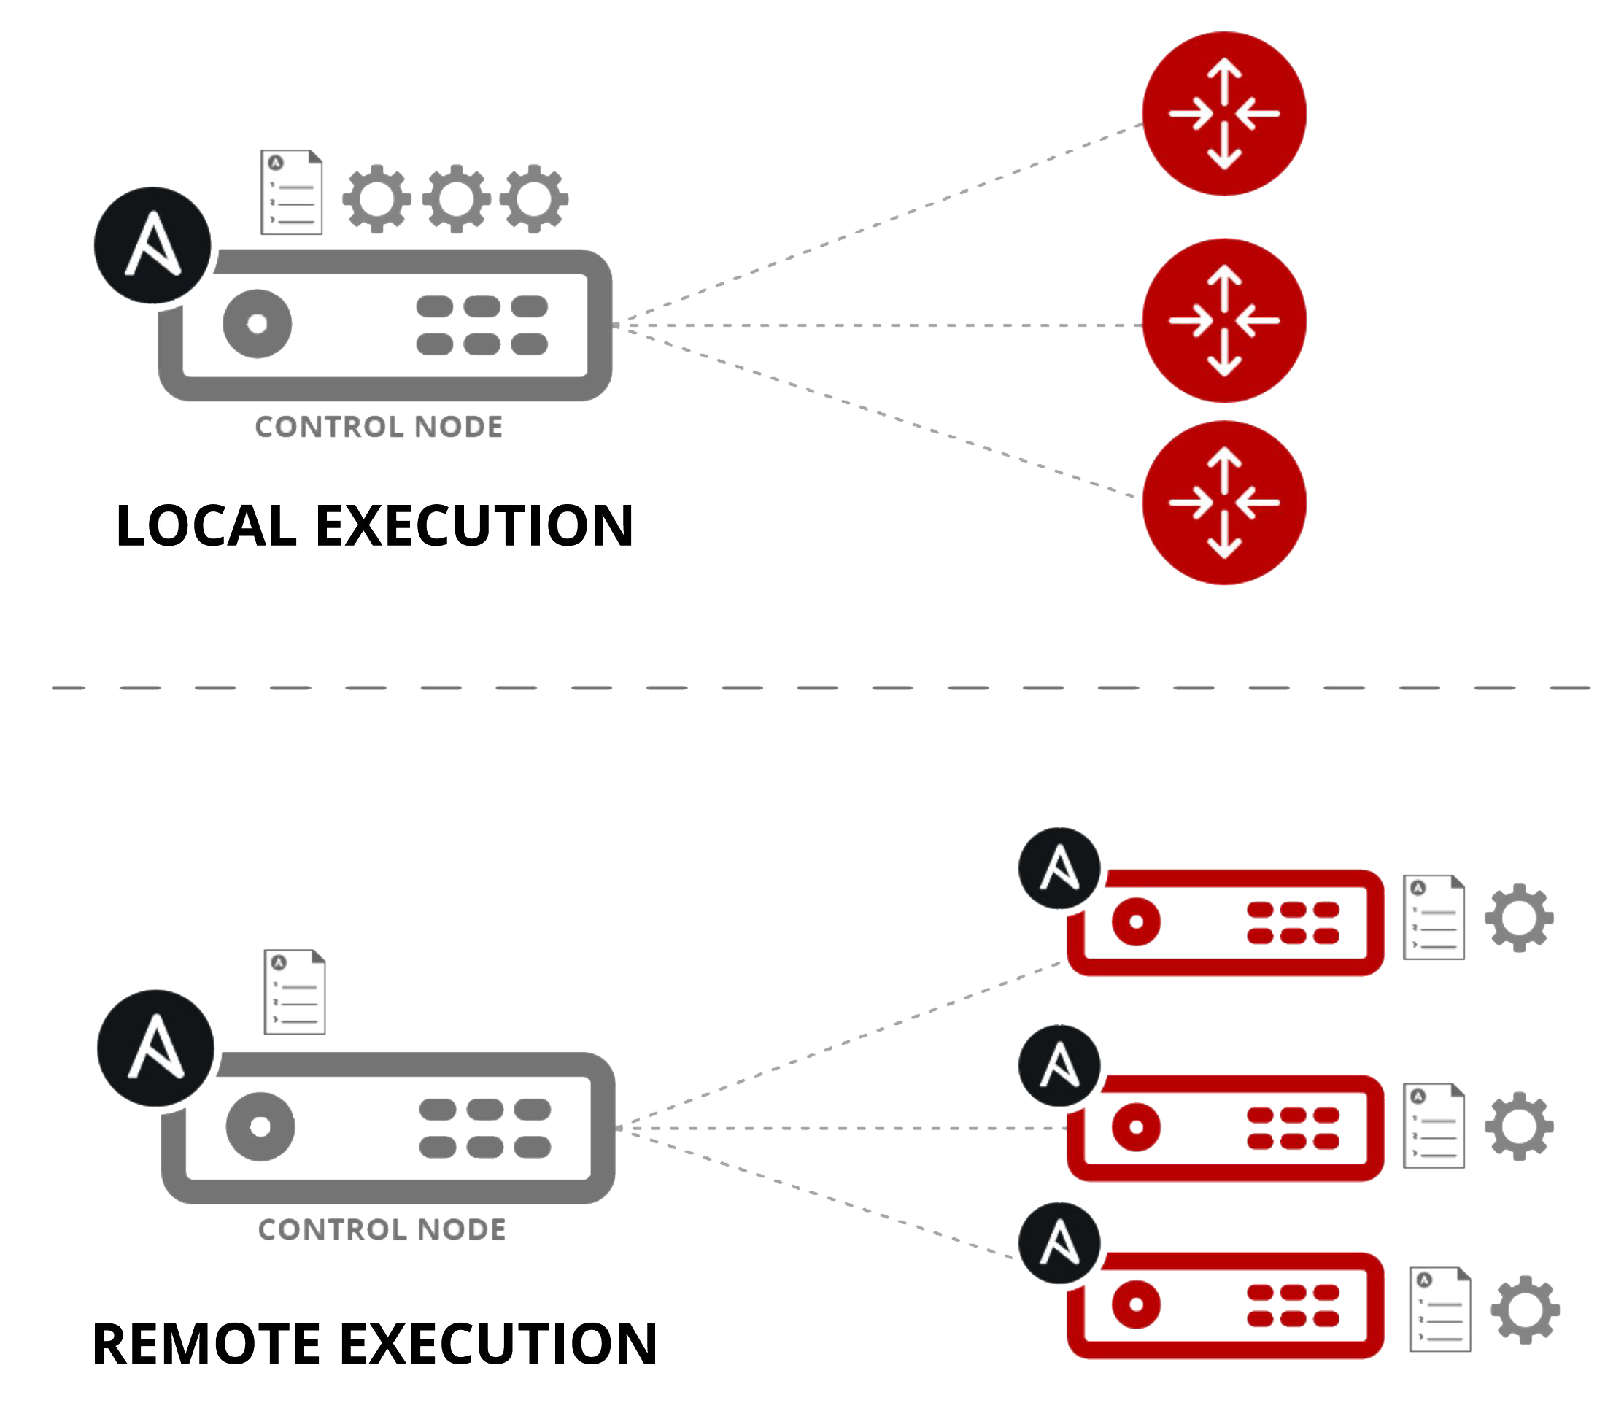
Ansible automation mechanism
Module code is executed locally on the control node
Équipements du réseau
Module code is copied to the target node, executed and then deleted
Hôtes
LINUX/WINDOWS

Slide 50
Other automation tools
Some of the best known:
- CFEngine Chef
- Puppet Salt Ansible
Frequently cited benefits for Ansible:
- Simplicity:
YAML Recipe
Nothing to install on the knots
Push mode (default): no dedicated server
- Complete: Description of the machine fleet, ad-hoc commands,. . .
Cons:
- Recipes: more a succession of tasks to be applied than a “high level” vision of the desired result
- Risk of bad practices, undetected errors
- May be slower (tasks applied individually instead of being analyzed globally)

Slide 51
Installation – Server from sources
○
From sources
$ git clone git://github.com/ansible/ansible.git
^{$ cd ./ansible}
^{$ source ./hacking/env-setup}
○
Additional python modules
^{sudo easy_install pip}
sudo pip install paramiko PyYAML jinja2 httplib2

Slide 52
Installation – Server with Apt
○
Latest version with apt
$ | sudo | apt-get install software-properties-common
$ | sudo | apt-add-repository ppa:ansible/ansible
$ | sudo | apt-get update
$ | sudo | apt-get install ansible

Slide 53
Installation – Server with Pip
○
Latest version with pip
^{$ sudo easy_install pip}
^{$ sudo pip install ansible}

Slide 54
Installation – Server with yum
○
Latest version with yum
# CENTOS
^{# INSTALL the epel repo}
^{yum install epel-release}
# RHEL
^{# ACTIVATE the extra repo}
subscription-manager repos --disable=rhel-7-server-extras-rpms
# INSTALL ANSIBLE
^{yum install ansible}

Slide 55
Configuration of Ansible
Display of the ansible configuration:
ansible-config list
You can change these configuration variables by filling in a configuration file.
Ansible will search in order (the first found will be used and the others will be ignored):
ANSIBLE_CONFIG (If the environment variable is valued)
./ansible.cfg (in the current folder, the working directory)
~/.ansible.cfg (at the root of the user folder as a hidden file)
/etc/ansible/ansible.cfg (in the software configuration folder)

Slide 56






Ansible tools
ansible provides several command-line tools
Outil | Description
ansible | Execution of a single command
ansible-playbook | Playbook execution (set of tasks at carry out)
ansible-doc | Access to listing + documentation of servers
ansible-vault | Encrypted file management (variable storage - word of pass)
ansible-galaxy | Access to ansible role repository
Exemple :
ansible –i hosts all –m ping

Slide 57
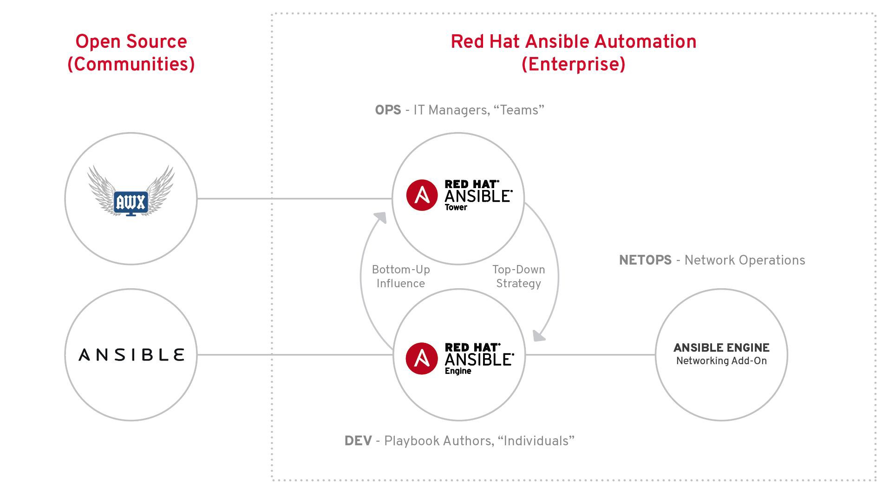
The different Ansible offers

Slide 58
Modules
Portions of code copied to the target system.
Executed to satisfy the task declaration.
Customizable.
Modules that ship with Ansible are all written in Python, but modules can be written in any language.

Slide 59
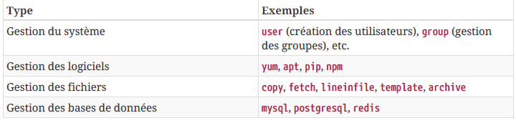
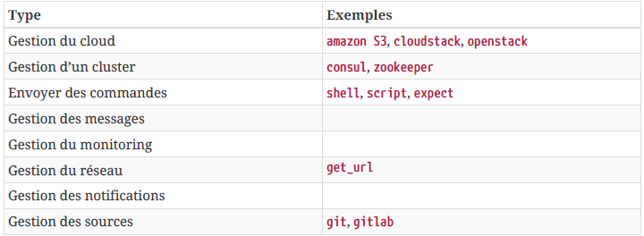
Modules
Wide choice/ secret force of Ansible...

Slide 60
The frequent modules
Outil | Description
ping | validation of the inventory
setup | returns a list of hardware information for the host
shell /command | to execute commands on hosts
user | allows you to manage users on hosts
file | allows you to manage file permissions
service | allows to manage system services such as: stop/start/reboot boot/activation or not at boot
yum/apt/ zypper | allows you to manage the installation, update and removal of packages.
The syntaxe is :
ansible (hote/groupe/all) –m MODULE [-a "arg1=val1"]
Example :
$ ansible all –m yum –a "name=httpd state=latest"

Slide 61
Modules documentation
# DISPLAYS ALL MODULES
ansible-doc -l
# ACCESSING MODULE DOCUMENTATION
ansible-doc <module_name>

Slide 62
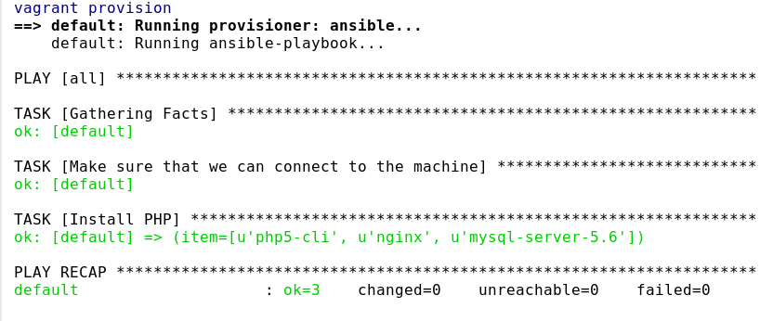
Principle of idempotence
Idempotence is a word that means you can do something several times and the result will always be the same.
In Ansible terms, a playbook is considered idempotent if you can run it multiple times and after the first run, the machine is in a certain state that does not change even if you re-run the same playbook.

Slide 63
What we have covered
Installation et configuration d’Ansible.
Composants de base d’Ansible.

Slide 64
Inventory file

Slide 65
Plan
Introduction
Notion d’inventaire
Inventaire – variable de communication
Inventaire – variable de communication
Inventaire – groupement de variables
Inventaire – groupes de groupes
Motifs utilisables

Slide 66
Introduction
Automation of tasks on client machines.
Need to provide information and addresses of remote customers.

Slide 67
Concept of inventory
Can be called from the current directory or via/etc/ansible/hosts
Can be called with the flag -i <filenames>
Can be dynamic, that is created by programming by injecting the results of inventory program in a JSON format
Variable Inventory: in ansible.cfg

Slide 68
Inventory – communication variable
ansible_connection : local, ssh
ansible_ssh_host : The remote hostname.
ansible_ssh_port : The ssh port number if different from 22
ansible_ssh_user : The user name of the remote machine.
ansible_ssh_pass : ssh password mandatory (not secure).
ansible_ssh_private_key_file : private key file used for ssh.

Slide 69
Inventory – hosts and groups
localhost
ansible_connection=local
[webservers]
web[1:5].example.com ansible_connection=ssh ansible_ssh_user=webadmin
[dbservers]
db[1:2].example.com ansible_connection=ssh ansible_ssh_user=dbadmin

Slide 70
Inventory – grouping of variables
[webservers]
web[1:5].example.com ansible_connection=ssh ansible_ssh_user=webadmin [webservers:vars]
http_port=80

Slide 71
Inventory – groups of groups
[atlanta]
host1 host2 [raleigh] host2 host3
[southeast:children] atlanta
raleigh

Slide 72
Usable patterns
All inventory hosts (all or *)
A hostname or group (host1, webservers)
Wildcards (192.168.1.*)
OR (host1:host2, webservers:dbservers)
NOT (webservers:dbservers:!production)
AND (webservers:dbservers:&staging)
REGEX (~(web|db).*\.example\.com)

Slide 73
What we have covered
Principle of inventories.
Hosts and groups.
Inventory variables.

Slide 74
Ad-hoc Commands

Slide 75
Plan
Ad-Hoc command syntax
COMMAND Ad-Hoc - examples

Slide 76
Ad-Hoc command syntax
$ ansible {pattern} -m {module} -a “{options}” {flags}
pattern : Which host?
module : Which ansible module? (default command)
options : What module options?
flags : Ansible command flags:
-u {username}: Execute the command as another user (current user by default)
--sudo: execute command via sudo
-K: Interactive request for sudo password
-U {username}: User to use with sudo other than root
-i {file}: inventory file if different from/etc/ansible/hosts

Slide 77
Ad-Hoc command syntax
To run your first Ansible command...
(sur quoi) (module) (arguments) # ansible all -i inventory -m module -a "uptime"
192.168.250.13 | success | rc=0 >>
18:57:01 up 11:03, 1 user, load average: 0.00, 0.01, 0.05
192.168.250.11 | success | rc=0 >>
18:57:02 up 11:03, 1 user, load average: 0.00, 0.01, 0.05

Slide 78
COMMANDE Ad-Hoc - examples
#Transfert of files
$ ansible all -m copy -a "src=/etc/hosts dest=/tmp/hosts“
# INSTALL THE HTTPD PACKAGE
ansible web -i ./hosts -m yum -a "name=httpd state=present"
# Start and Activate the httpd SERVICE
ansible web -i ./hosts -m service -a "name=httpd enabled=yes state=started"
# Collect of facts
$ ansible all -m setup

Slide 79
LAB # 1
Ansible Commands
Objectives
Using the Ansible command, perform the following tasks:
Test the Ansible connection to all your hosts using the Ping module
Install the emacs repository on all your hosts
Remove the git package from your local host.

Slide 80
LAB #1 - SOLUTION
ansible all -i inventory -m ping
ansible all -i inventory -m yum -a "name=emacs state=present"
ansible localhost -m yum -a "name=git state=absent"

Slide 81
What we have covered
Principle of ad hoc orders.
Syntaxes and options.

Slide 82
Yaml language

Slide 83
Plan
Introduction
Syntaxes
Syntax complexes
Syntaxes: abbreviated forms
Syntaxes: multi-line values
Syntaxes: boolean values
Syntaxes : variables

Slide 84
Introduction
YAML, acronym of "Yet Another Markup Language" in its version 1.0, it becomes the recursive acronym of "YAML Ain’t Markup Language" ("YAML is not a markup language") in its version 1.1.
Mainly designed for the representation of data structures
Easy to write, format that can be read by humans
Design objective: to abandon traditional “cloistered” syntax
A format for representing data by Unicode serialization. It takes concepts from other languages such as XML.

Slide 85
Syntaxes
All YAML files can optionally start with --- and end with ... .
It consists of different blocks: each sub-block is advanced by two spaces compared to the parent block.
List: It allows to define lists whose items should be preceded by dash - and space.
- Apple
- Orange
- Strawberry
- Mango

Slide 86
Syntaxes
Dictionaries: A dictionary is represented in a simple form (the colon must be followed by a space): key: value
ahmed:
name: ahmed hosni
job: Consultant
skill: DevOps

Slide 87
Syntax complexes
- martin:
name: Martin
job: Developpeur
skills:
- python
- perl
- pascal
- alice:
name: Alice
job: Developpeur
skills:
- lisp
- fortran
- erlang

Slide 88
Syntaxes : abbreviated forms
Dictionaries and lists can also be represented in an abbreviated form if you really want:
martin: {name: Martin, job: Developer, skill: Elite}
Fruits: ['Apple', 'Orange', 'Strawberry', 'Mango']

Slide 89
Syntaxes : multi-line values
include_newlines: |
exactly as you see
will appear these three
lines of poetry
fold_newlines: >
this is really a
single line of text
despite appearances

Slide 90
Syntaxes : boolean values
create_key: yes
needs_agent: no
knows_oop: True
likes_emacs: TRUE
uses_cvs: false

Slide 91
Syntaxes : variables
Variables are called in the Ansible playbooks written in YAML and framed by double braces with space (Jinja2).
- name: "print ansible_hostname variable play"
hosts: all
gather_facts: True
tasks:
- name: "print ansible_hostname variable task"
debug:
msg: "{{ ansible_hostname }}"

Slide 92
What we have covered
Syntax of YAML.
Tags and spacing.
Human language.
Organization and scheduling.

Slide 93
Playbook

Slide 94
Plan
Introduction
Playbook structure
Task Inclusion Playbook
A “play” in a “playbook”
Common elements of a game
Running a playbook: color codes
Running a playbook
Management of managers
Run an ansible playbook

Slide 95
Introduction
A playbook contains instructions for configuring your hosts.
A playbook contains one or more plays.
A play is a task.
Playbooks are in YAML format.
Uses minimal syntax.
Made to be readable.
Must be idempotent, that is to say executed several times, the result will be the same.
May be divided into templates or roles.
More efficient to execute multiple tasks than on the command line.

Slide 96
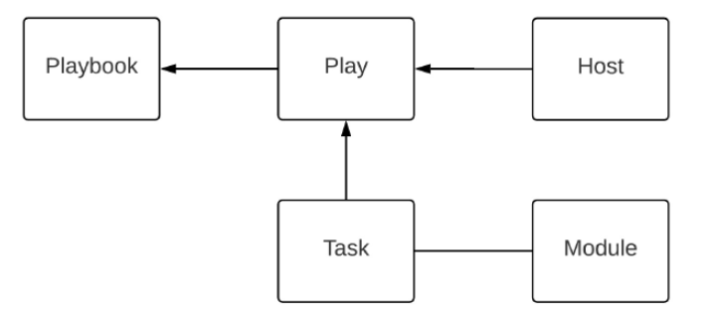
Playbook structure

Slide 97
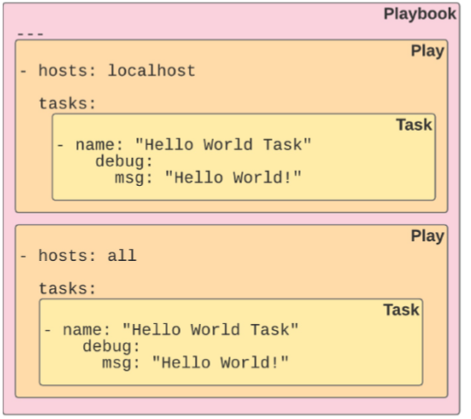
Playbook structure

Slide 98
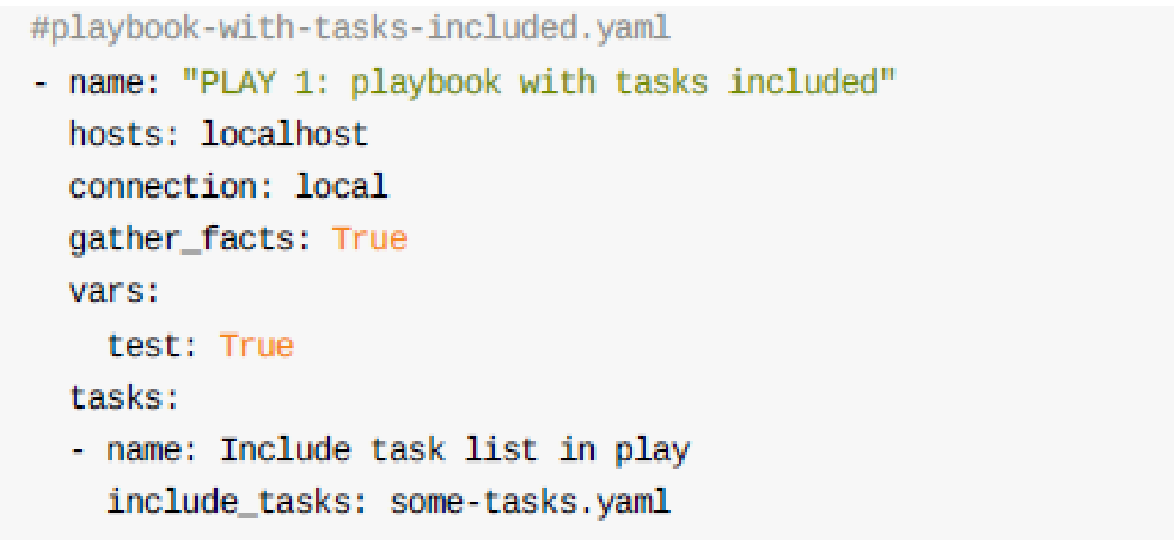
Task Inclusion - Playbook

Slide 99
A “play” in a “playbook”
- hosts: db vars:
software:
- mariadb-server roles:
- install_wordpress_db
Play 1
- hosts: web
vars:
software:
- httpd
- php roles:
- install_wordpress_web
Another
play

Slide 100
A “play” in a “playbook”
- hosts: db
vars:
software:
- mariadb-server roles:
- install_wordpress_db
Play 1
hosts: web vars:
software:
httpd
php roles:
- install_wordpress_web
Another
play

Slide 101
A “play” in a “playbook”
hosts: db vars:
software:
- mariadb-server roles:
- install_wordpress_db
hosts: web vars:
software:
httpd
php roles:
- install_wordpress_web
Play 1
Another
play

Slide 102
Common elements of a play
This is not an exhaustive list but contains the elements commonly used in a play
hosts | The declaration of the list of hosts/ groups affected by the play
connection | Allows you to change the connection plugin used for tasks to be executed
port | Overrides the default connection port
remote_user | Remote user: overloads the specified user in the inventory
become | Boolean controlling the gain of privilege on the remote machine when executing the task. (with become_user, become_method)

Slide 103
Common elements of a play
information processing
name | Identifier: can be used for documentation, tasks or handlers
gather_facts | Boolean to bypass the collection of facts in order to speed up. This content can be found with the setup module
no_log | boolean controlling the information logging.
ignore_errors | Boolean; if true, ignore errors except those that are fatal for playbook execution.
check_mode | Known as “dry run”, evaluates execution without actually executing.

Slide 104
Common elements of a play
Processing of the inventory
order
Controls the order of hosts for playbook execution.
Processing of varaibles
vars | Dictionary of variables
vars_files | List of files containing variables to include.
vars_prompt | List of variables to type on the keyboard.

Slide 105
Common elements of a play
Processing of tasks:
pre_tasks | A list of tasks to be performed with the tasks.
roles | List of roles to import into play.
tasks | Main tasks to be performed in the pla; they are performed after roles and before post_tasks
post_tasks | A list of tasks that run after the task section.
handlers | Tasks that are performed following a notification by other tasks.

Slide 106
Common elements of a play
- name: install a LAMP stack hosts: web,db,appserver01 become: yes
vars:
my_greeting: Welcome to my awesome page
favorite_food: fried pickles
roles:
- install_lamp_elements
tasks:
- name: write the index file copy:
content: “{{ my_greeting }}. Enjoy some {{ favorite_food }}" dest: /var/www/html/index.html
notify: reload_apache
handlers:
- name: reload_apache service:
name: httpd
state: reloaded

Slide 107
Common elements of a play
- name: install a LAMP stack hosts: web,db,appserver01 become: yes
vars:
my_greeting: Welcome to my awesome page
favorite_food: fried pickles
roles:
- install_lamp_elements
tasks:
- name: write the index file copy:
content: “{{ my_greeting }}. Enjoy some {{ favorite_food }}" dest: /var/www/html/index.html
notify: reload_apache
handlers:
- name: reload_apache service:
name: httpd
state: reloaded

Slide 108
Common elements of a play
tasks:
name: Ensure httpd package is present yum:
name: httpd
state: latest
name: Ensure latest index.html file is present copy:
src: files/index.html
dest: /var/www/html/
name: Restart httpd service:
name: httpd
state: restart

Slide 109
Common elements of a play
tasks:
- name: Ensure httpd package is present
yum:
name: httpd
state: latest
- name: Ensure latest index.html file is present
copy:
src: files/index.html
dest: /var/www/html/
- name: Restart httpd
service: name: httpd
state: restart

Slide 110
Common elements of a play
tasks:
- name: Ensure httpd package is present
yum:
name: httpd
state: latest
- name: Ensure latest index.html file is present copy:
src: files/index.html
dest: /var/www/html/
- name: Restart httpd
service: name: httpd
state: restart

Slide 111
Common elements of a play
tasks:
- name: Ensure httpd package is present
yum:
name: httpd
state: latest
- name: Ensure latest index.html file is present
copy:
src: files/index.html
dest: /var/www/html/
- name: Restart httpd service:
name: httpd
state: restart

Slide 112
Running a playbook: color codes
Vert: A task performed correctly without making any changes.
Jaune: A task performed correctly and introduces changes.
Blanc: General information and headings.
Bleu: A conditional task ignored.
Violet: An outdated warning or bug.
Rouge: A failed task.

Slide 113
Running a playbook
[user@ansible] $ ansible-playbook apache.yml
PLAY [webservers] ***************************************************************************
TASK [Gathering Facts] ********************************************************************** ok: [web2]
ok: [web1]
ok: [web3]
TASK [Ensure httpd package is present] ****************************************************** changed: [web2]
changed: [web1]
changed: [web3]
TASK [Ensure latest index.html file is present] ********************************************* changed: [web2]
changed: [web1]
changed: [web3]
TASK [Restart httpd] ************************************************************************ changed: [web2]
changed: [web1]
changed: [web3]
PLAY RECAP **********************************************************************************
web2 : | ok=1 | changed=3 | unreachable=0 | failed=0
web1 : | ok=1 | changed=3 | unreachable=0 | failed=0
web3 : | ok=1 | changed=3 | unreachable=0 | failed=0

Slide 114
Running a playbook
[user@ansible] $ ansible-playbook apache.yml
PLAY [webservers] ***************************************************************************
TASK [Gathering Facts] **********************************************************************
ok: [web2]
ok: [web1]
ok: [web3]
setup module
TASK [Ensure httpd package is present] ******************************************************
changed: [web2] changed: [web1] changed: [web3]
yum module
TASK [Ensure latest index.html file is present] *********************************************
changed: [web2] changed: [web1] changed: [web3]
copy module
TASK [Restart httpd] ************************************************************************
changed: [web2] changed: [web1] changed: [web3]
service module
PLAY RECAP **********************************************************************************
web2 : | ok=1 | changed=3 | unreachable=0 | failed=0
web1 : | ok=1 | changed=3 | unreachable=0 | failed=0
web3 : | ok=1 | changed=3 | unreachable=0 | failed=0

Slide 115
Management of handlers
A handler is executed when a task notifies it of a change.
tasks:
- name: Ensure httpd package is present yum:
name: httpd
state: latest
notify: restart_httpd
handlers:
- name: restart_httpd service:
name: httpd
state: restarted

Slide 116
Management of handlers
tasks:
- name: Ensure httpd package is present yum:
name: httpd
state: latest
notify: restart_httpd
- name: Standardized index.html file copy:
content: "This is my index.html file for {{ ansible_host }}"
dest: /var/www/html/index.html
notify: restart_httpd
If one of the tasks notifies a change, the handler will be notified only once.
TASK [Ensure httpd package is present] ******************************************************
ok: [web2]
ok: [web1]
unchanged
TASK [Standardized index.html file] *********************************************************
changed: [web2] changed: [web1]
changed
NOTIFIED: [restart_httpd] ******************************************************************* changed: [web2]
changed: [web1]
handler runs once

Slide 117
Management of handlers
tasks:
- name: Ensure httpd package is present yum:
name: httpd
state: latest
notify: restart_httpd
- name: Standardized index.html file copy:
content: "This is my index.html file for {{ ansible_host }}"
dest: /var/www/html/index.html
notify: restart_httpd
If both tasks notify a change, the handler will be notified only once.
TASK [Ensure httpd package is present] ****************************************************** changed: [web2]
changed: [web1]
changed
TASK [Standardized index.html file] ********************************************************* changed: [web2]
changed: [web1]
changed
NOTIFIED: [restart_httpd] ******************************************************************* changed: [web2]
changed: [web1]
handler runs once

Slide 118
Management of handlers
tasks:
- name: Ensure httpd package is present yum:
name: httpd
state: latest
notify: restart_httpd
- name: Standardized index.html file copy:
content: "This is my index.html file for {{ ansible_host }}"
dest: /var/www/html/index.html
notify: restart_httpd
If no task notifies change, the handler will not be notified.
TASK [Ensure httpd package is present] ****************************************************** ok: [web2]
ok: [web1]
unchanged
TASK [Standardized index.html file] ********************************************************* ok: [web2]
ok: [web1]
unchanged
PLAY RECAP **********************************************************************************
web2 web1
: ok=2
: ok=2
changed=0 changed=0
unreachable=0 unreachable=0
failed=0 failed=0
skipped=0 skipped=0
rescued=0 ignored=0 rescued=0 ignored=0

Slide 119
RUN AN ANSIBLE PLAYBOOK
[centos@centos7-1 ansible]$ ansible-playbook play.yml -i inventory

Slide 120
RUN AN ANSIBLE PLAYBOOK
In verification mode only
[centos@centos7-1 ansible]$ ansible-playbook play.yml -i hosts –check

Slide 121
What we have covered
Principle of playbooks.
Remote task execution script.
Different parts and blocks.

Slide 122
Variables

Slide 123
Plan
Introduction
Keying in
Internal and external variables
Retrieving the result of a command
Facts: Magic variables

Slide 124
Introduction
Variables typed on the keyboard.
Variables defined in the script.
Variables included from external files.
Facts: Magic variables

Slide 125
Variables typed on the keyboard.
Defined in the playbook by the "vars_prompt" module:
- hosts: localhost
vars_prompt:
- name: "name"
prompt: “Quel est votre prénom?"
private: no
tasks:
- debug:
msg: “Bonjour {{ name }} “

Slide 126
internal and external variables
It is good practice to organize your procedures with variables.
Ansible variables can be declared in different places:
in the inventory, in group_vars/ or host_vars/ folders for example.
They can also be defined via the command line: ansible-playbook –e
They can be defined in the playbooks in various forms:
in direct evaluation in the task or in the game or in the role ( vars: )
referring to a file ( vars_files: )
by "including" ( include_vars: )
by calling environment variables
importing other playbooks ( import_playbook: )

Slide 127
internal and external variables
It is good practice to organize your procedures with variables.
Ansible variables can be declared in different places:
in the inventory, in group_vars/ or host_vars/ folders for example.
They can also be defined via the command line: ansible-playbook –e
They can be defined in the playbooks in various forms:
per generation or dynamic harvest (gather_facts:)
defined by playbook tasks ( set_facts: )
defined from the standard output of a task ( register: )
defined from interactive prompts ( vars_prompt:)
From default/ or variable/ folders of a role

Slide 128
internal and external variables
Defined in the playbook
- hosts: webservers
vars:
http_port: 80
Default variables of roles: {{ role }}/defaults/main.yml
Included Variables
---
- hosts: all remote_user: root vars:
favcolor: blue
vars_files:
- /vars/external_vars.yml

Slide 129


Retrieving the result of a command

Slide 130
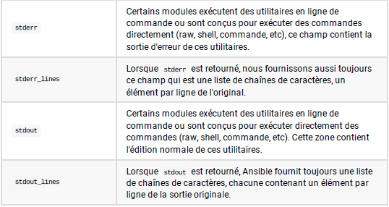
Retrieving the result of a command

Slide 131
Retrieving the result of a command
- name: "print df -Th"
hosts: localhost
gather_facts: True
tasks:
- shell: df -h
register: df_output
- debug:
msg: "{{ df_output.stdout_lines | list }}"

Slide 132
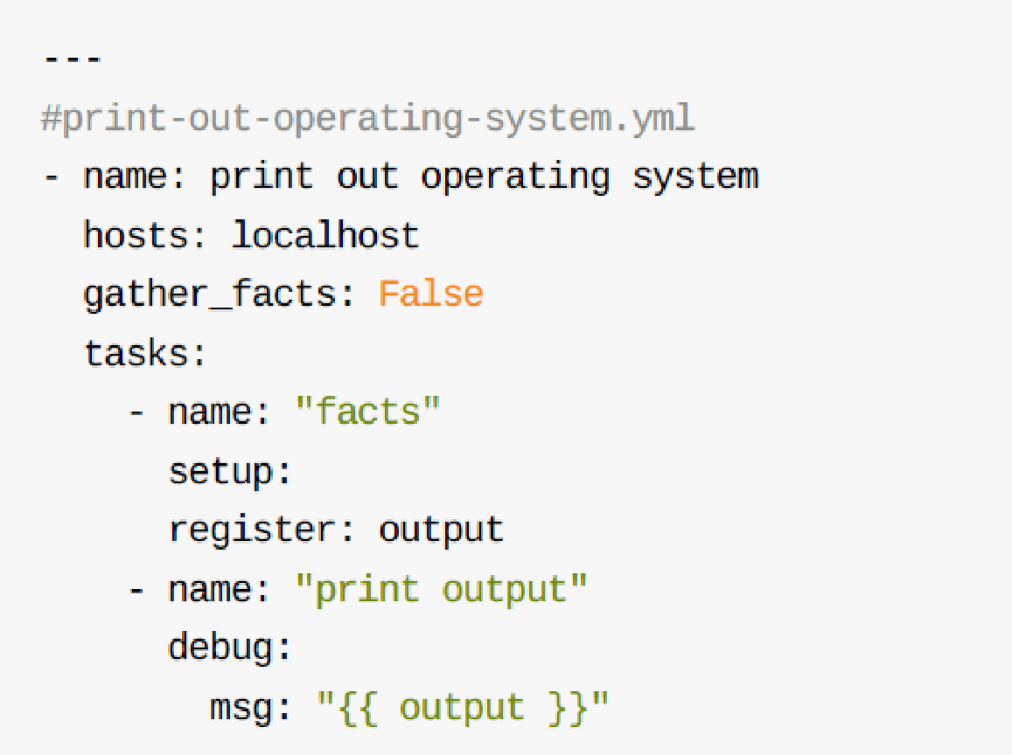
Facts : Magic Variables
The facts are about getting information from your hosts.
They start with ansible_
You can use Facts in your playbook variables.
Feedback from facts can be blocked to improve performance:
- hosts: mainserver
gather_facts: no
The facts are provided by the setup module:

Slide 133
Facts : Variables magiques
Some magic variables:
ansible_distribution
ansible_distribution_release
ansible_distribution_version
ansible_fqdn
ansible_hostname
ansible_os_family
ansible_pkg_mgr
ansible_default_ipv4.address
ansible_default_ipv6.address

Slide 134
What we have covered
Types of variables used by playbooks.
Variables typed on the keyboard.
Internal and external variables.
Magic variables.

Slide 135
control structures

Slide 136
Plan
Introduction
Conditional structures
Conditional structures - example
Condition according to a previous state
Loop structures
Concept of blocks
Exception Management
Ignore failed tasks

Slide 137
Introduction
Ansible integrates complex structures with simple tasks.
Conditional structures can be written to control the execution of a specific task.
Loops are also provided to browse a list of values.

Slide 138
conditional structures
Conditions are introduced following the task concerned via the keyword “when”:
var == "Value" , var >= 5 , etc.
var , where var is a boolean ( yes , true , True , TRUE )
var is defined , var is not defined , ! var is defined
<condition1> and <condition2>
<condition1> or <condition2>
(<condition1> and <condition2>) or (<condition3> and <condition4>)
Facts can be formulated as elements of an ansible_facts table:
ansible_os_family : ansible_facts[‘os_family’]

Slide 139
conditional structures- example
- name: "playbook handler"
hosts: all
become: yes
vars_prompt:
- name: "response"
prompt: "tu veux executer?\n1-yes\n2-no"
private: no
tasks:
- name: "tache 1"
command: "true"
notify: print state
when: response == "1"
- name: "tache 2"
debug:
msg: "bye"
when: response == "2"
handlers:
- name: "print state"
debug:
msg: "parfait!"

Slide 140
Condition according to a previous state
- name: Ensure httpd package is present yum:
name: httpd
state: latest
register: httpd_results
- name: Restart httpd service:
name: httpd
state: restart
when: httpd_results.changed

Slide 141
Loop structures
Loops allow you to iterate on list and dictionary variables.
This technique allows the same action to be performed several times on an undefined number of elements when writing the role or playbook.

Slide 142
Loop structures
The initiation of the loop is carried out using the keyword “loop”:
- name: "loop illustration"
hosts: localhost
vars:
fruits:
- apple
- orange
- pineapple
tasks:
- name: "Print my Fruits"
debug:
msg: "{{ item }}"
loop: "{{ fruits }}"

Slide 143
Loop structures
The initiation of the loop is carried out using the keyword “loop”:
- name: "loop illustration"
hosts: localhost
vars:
fruits:
- apple
- orange
tasks:
- name: "loop with register"
shell: "echo {{ item }}"
loop: "{{ fruits }}"
register: echo
- name: "affichage resultats"
debug:
msg: "{{ echo }}"

Slide 144
Loop structures
The initiation of the loop is carried out using the keyword “loop”:
- name: "loop illustration"
hosts: localhost
vars:
fruits:
- name: apple
color: green
- name: orange
color: orange
- name: pineapple
color: yellow
tasks:
- name: "Print my Fruits"
debug:
msg: "{{ item.name }} is {{ item.color }}"
loop: "{{ fruits }}"

Slide 145
Loop structures
- name: "loop illustration"
hosts: localhost
vars:
fruits:
- id: 0
name: apple
colors:
- id: 0
name: green
tasks:
- name: "Print my Fruits"
debug:
msg: "{{ item.0.name }} is {{ item.1.name }}"
loop: "{{ fruits|product(colors)|list }}"

Slide 146
Concept of blocks
Blocks allow logical grouping of tasks and error handling in the play.
Anything that can be applied to a single task can be applied at the block level, which also facilitates the definition of common data or guidelines for tasks.
The instructions will be applied to the tasks, but not to the block itself.

Slide 147
Concept of blocks
tasks:
- name: Install Apache
block:
- yum:
name:
- httpd
- memcached
state: installed
- service:
name: bar
state: started
enabled: True
when: ansible_distribution == 'CentOS'
become: true
become_user: root

Slide 148
Exception handling
Blocks can also be used to handle error outputs in a similar way to the exceptions of most programming languages.
The tasks of the block: are executed normally.
In case of an error, the rescue: section runs with everything you need to do to resolve the previous error.
The always: section is executed regardless of the previous error that occurred or not in the block: and rescue:

Slide 149
Exception handling
tasks:
- name: Attempt and graceful roll back demo
block:
- debug:
msg: 'I execute normally'
- command: /bin/false
- debug:
msg: 'I never execute, due to the above task failing'
rescue:
- debug:
msg: 'I caught an error'
- command: /bin/false
- debug:
msg: 'I also never execute :-('
always:
- debug:
msg: "This always executes"

Slide 150
Ignore failed tasks
A task that fails (failed) stops playing the playbook.
ignore_errors overrides this behavior:
- name: this will not be counted as a failure
command: /bin/false
ignore_errors: yes

Slide 151
What we have covered
Loops and conditional structures.
Blocks and error handling.

Slide 152
Tags

Slide 153
Plan
Introduction
Application of tags
Execution of tags
Special tags
Reuse of tags

Slide 154
Introduction
If you have a large playbook, it may be useful to be able to run only a specific part of it rather than reading everything.
Ansible supports a tags: attribute for this reason.
When you run a playbook, you can filter tasks based on "tags" in two ways:
On the command line, with --tags or -skip-tags options
In the Ansible configuration settings, with the options TAGS_RUN and TAGS_SKIP

Slide 155
Application of tags
The "tags" can be applied to many structures in Ansible:
tasks:
roles:
blocks:
import_roles:
import_tasks:

Slide 156
Application of tags
Example of tag usage
tasks:
yum:
name={{ item }}
state=installed
with_items:
- httpd
- memcached tags:
packages
template:
src=templates/src.j2
dest=/etc/foo.conf
tags:
configuration

Slide 157
Execution of tags
Execution with tags
ansible-playbook example.yml --tags “configuration”
ansible-playbook example.yml --skip-tags "notification"
Ansible-playbook example.yml –tags “configuration,notification”

Slide 158
Special Tags
"always" : always executed as long as it is explicitly avoided
( --skip-tags always )
"never" : never executed unless explicitly mentioned ( --tags never )
"tagged" : Only performs tagged tasks
"untagged" : Only performs unmarked tasks.
"all" : performs all tasks marked or not
ansible-playbook example.yml --tags “tagged” ansible-playbook example.yml --tags “untagged” ansible-playbook example.yml --tags “all”

Slide 159
Reuse of tags
It is possible to apply the same "tag" to several tasks.
When running a playbook using the --tags command line option, all tasks with this "tag" name will be executed.

Slide 160
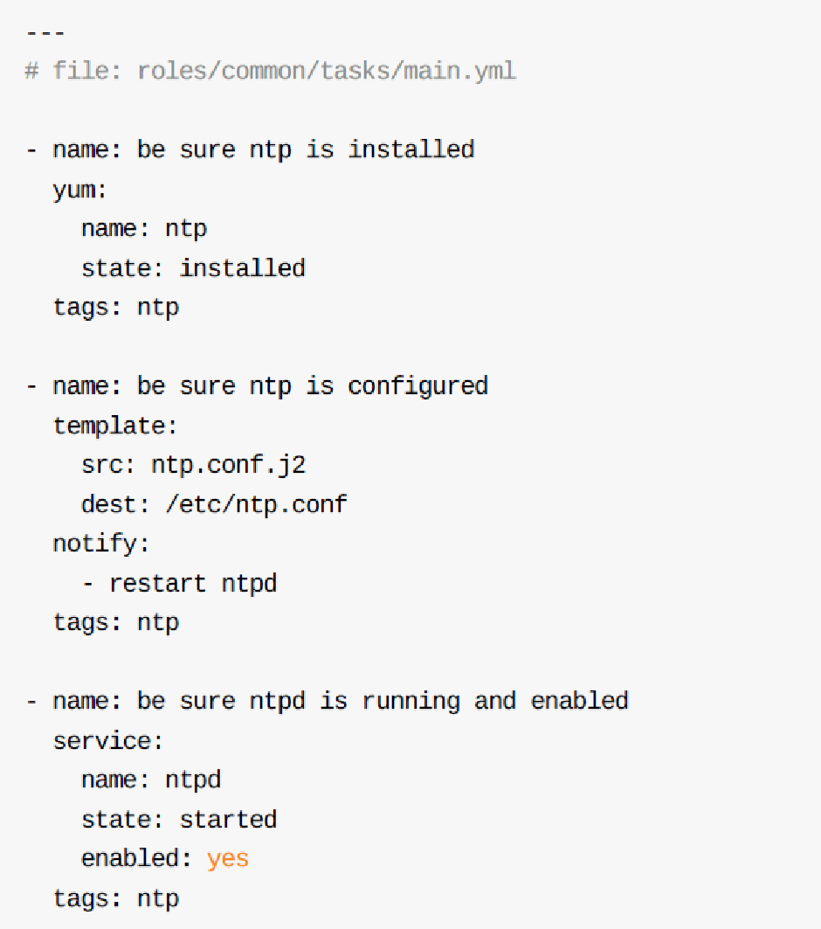
Reuse of tags
This example tags several tasks with a "tag" "ntp":

Slide 161
What we have covered
Labeling of blocks and tasks.
Execution of the playbook by parts according to the tags indicated.

Slide 162
Roles

Slide 163
Plan
Include / Import
Difference between import_* and include_*
Role management
Include_role
Ansible Galaxy

Slide 164
Include / Import
It is possible to "include" in a playbook files that include a list of plays or tasks with an include* module.
the include module is deprecated since Ansible 2.4 version in favor of include_tasks.
There is also the import_tasks module whose operation is similar to include_tasks

Slide 165
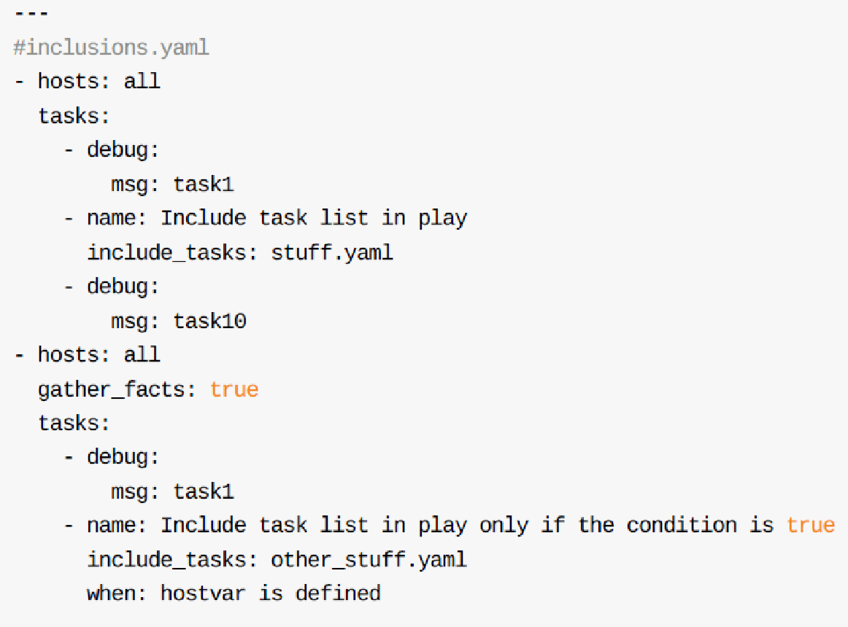
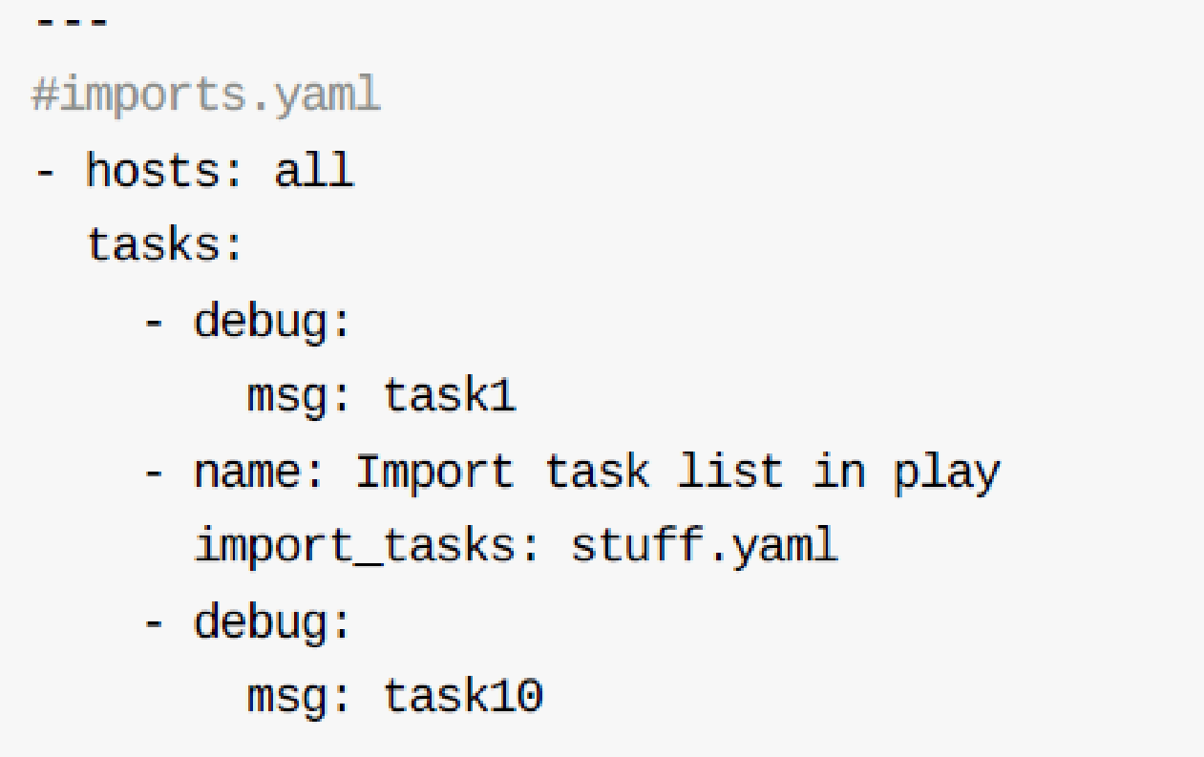
Include / Import

Slide 166
Difference between import_* and include_*
All import_* instructions are pre-processed at the time of playbook analysis. All instructions include_* are processed as the playbook is executed.
Import is static, inclusion is dynamic.
In practice, import is used with logical "units".
For example, a long list of tasks in sub-task files.
we use include to process different workflows and make decisions based on "gathered facts" in a dynamic way.

Slide 167
Role management
A playbook is a single file that allows Ansible to install your hosts.
A role to be seen as a playbook file divided into several files:
one for tasks another for variables, another for handlers and so on.
Roles add modularity to your playbooks, you can reuse them by including roles in your playbooks.
Ansible galaxy is a cloud repository of roles already defined by a community of developers.

Slide 168
Role management
Directory structure
roles
└── myapp
├── defaults
├── files
├── handlers
├── meta
├── tasks
├── templates
└── vars
To automatically create a file structure
ansible-galaxy init <role_name>

Slide 169
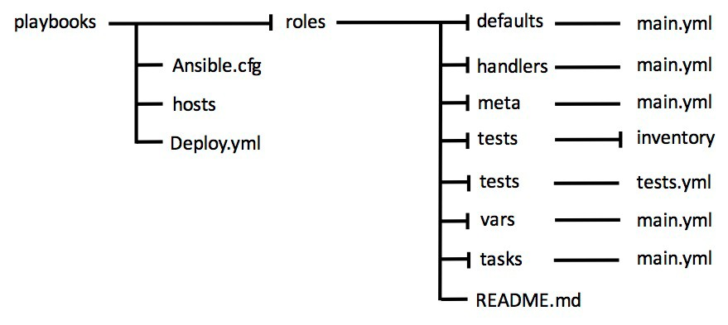
Role management
Our role is well established and contains the following directories:
Thanks to this tree it will not be necessary to specify the directives vars, tasks or handlers in the files vars/main.yml, tasks/main.yml and handlers.yml
this information will be obtained from the name of the role directory.

Slide 170
Role management
For example a tasks/main.yml file will contain only a list of tasks:
In the same way, the copy and template modules will fetch the source files directly from the files and templates directories, without having to specify them in the path.
Example : a tasks/main.yml file will contain only a list of tasks
name: Install Apache
apt:
name=apache2
state=present
name: Ensure service is registered and running service:
name=apache2
enabled=true
state=started

Slide 171
Gestion des rôles
Example of playbook
---
hosts: webservers roles:
common
webservers

Slide 172
Gestion des rôles
Example of playbook
---
- hosts: webservers roles:
- common
- { role: myapp, | dir: '/opt/a', | port: 5000 }
- { role: myapp, | dir: '/opt/b', | port: 5001 }

Slide 173
Gestion des rôles
Example of playbook
---
- hosts: webservers roles:
- { role: foo, when: "ansible_os_family == 'RedHat'" }

Slide 174
Gestion des rôles
Pre and post - example “rolling upgrade”
---
hosts: webservers serial: 1
pre_tasks:
- command:lb_rm.sh {{ inventory_hostname }} delegate_to: lb
command: mon_rm.sh {{ inventory_hostname }} delegate_to: nagios
roles:
myapp
post_tasks:
command: mon_add.sh {{ inventory_hostname }} delegate_to: nagios
- command: lb_add.sh {{ inventory_hostname }} delegate_to: lb

Slide 175
Include_role
The include_role module allows you to load a role as a dynamic task.
- name: Run tasks/other.yaml instead of 'main’
include_role:
name: myrole
tasks_from: other

Slide 176

Ansible Galaxy
http://galaxy.ansible.com

Slide 177
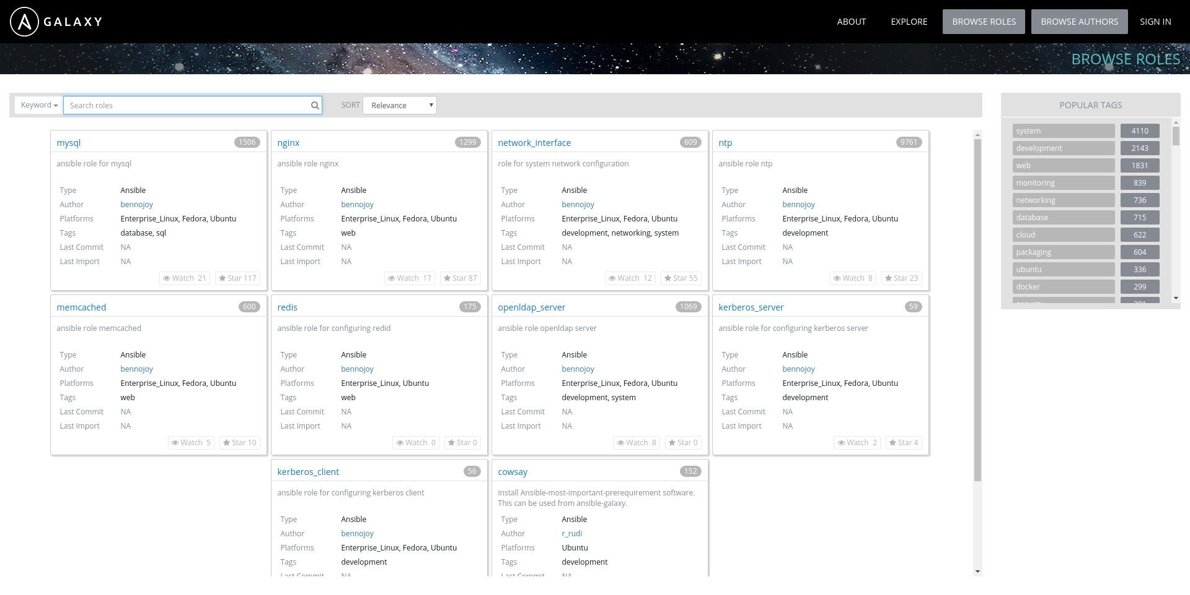
ANSIBLE GALAXY

Slide 178
ANSIBLE GALAXY
# ansible-galaxy search 'install git' --platforms el Found 176 roles matching your search:
Name...
# ansible-galaxy install davidkarban.git -p roles
# ansible-galaxy list -p roles
# ansible-galaxy remove -p roles

Slide 179
LAB
Convert Lab 3 playbook into two roles
Objectives
1. Create two roles : common et apache
common: install the facter package defined as variable
apache: installs the httpd package; copies the index.html file to the remote/var/www/html machine. Finally, it starts the corresponding service if the package is installed.
2. Create a playbook to apply these roles.
common: should be applied to all servers
apache: should be applied to your web group

Slide 180
LAB - SOLUTION 1/3
Creating directories using Ansible Galaxy template
[centos@centos1 ~]$ cd ansible ; mkdir roles ; cd roles
[centos@centos1 roles]$ ansible-galaxy init common ; ansible-galaxy init apache
apache role
[centos@centos1 roles]$ cd apache [centos@centos1 apache]$ vim tasks/main.yml
---
# tasks file for apache
name: Install Apache
yum:
name=httpd
state=present
notify: Start Apache
name: Copy Index.html template
copy:
src=index.html
dest=/var/www/html/index.html
[centos@centos1 apache]$ vim handlers/main.yml
---
# handlers file for apache
name: Start Apache
service:
name=httpd
state=restarted
enabled=yes

Slide 181
LAB - SOLUTION 2/3
Common role
[centos@centos1 apache]$ cd ../common
[centos@centos1 common]$ vim tasks/main.yml
---
# tasks file for common
name: install
yum:
name={{ paquet }}
state=present
[centos@centos1 common]$ vim vars/main.yml
# vars file for common
paquet: facter
‹#› Ansible Workshop

Slide 182
LAB - SOLUTION 3/3
Playbook
[centos@centos1 common]$ cd ../../ [centos@centos1 ansible]$ vim lab.yaml
---
name: All server setup hosts: all
become: yes
roles:
common
name: Web server setup hosts: web
become: yes
roles:
apache
[centos@centos1 ansible]$ ansible-playbook -i ./hosts lab.yml
‹#› Ansible Workshop

Slide 183
What we have covered
Differences between includes and import.
Concept of roles.
Role manipulation.
Ansible Galaxy.

Slide 184
Ansible Vault

Slide 185
Plan
Introduction
ansible-vault
Encryption with ansible-vault
Running Ansible with encrypted variables
Ansible-vault – other commands
Additional remarks

Slide 186
Introduction
Playbooks often access sensitive information: administrator passwords and databases, private keys,...
Ansible vault allows to secure any sensitive data while allowing the playbook execution.
If the key is provided, Ansible automatically decrypts passwords encrypted by vault.

Slide 187
ansible-vault
Any encrypted content is seamlessly embedded in Ansible with vault.
Ansible-vault allows encryption of any sensitive data on the disk.
Any command of ansible and ansible-playbook supports decrypting encrypted content at runtime.

Slide 188
Encryption with ansible-vault
Ansible vault is typically used to encrypt variable files.
Encryption of an existing file:
ansible-vault encrypt defaults/main.yml
Creation of an encrypted file:
Ansible-vault create defaults/extra.yml
These orders will require the entry and confirmation of a password.

Slide 189
Running Ansible with encrypted variables
Request vault password:
ansible-playbook --ask-vault-pass -i inventory_file some_playabook.yml
Using a vault file containing the password:
echo "secret_password" > vault_password
ansible-playbook --vault-password-file=vault_password -i inventory_file some_playabook.yml

Slide 190
Ansible-vault – other commands
Modify an encrypted file:
ansible-vault edit defaults/main.yml
Decrypt a file:
ansible-vault decrypt defaults/main.yml
Display the contents of an encrypted file (read-only):
ansible-vault view defaults/main.yml

Slide 191
Ansible-vault – other commands
Change password for encrypted files:
ansible-vault rekey defaults/main.yml
You will be prompted to enter the current password before changing it.
A message will be displayed to indicate the success of the new encryption process.

Slide 192
additional remarks
If the password is lost, the encrypted data is permanently lost.
If you manage the Ansible roles with git, you will notice that only opening an encrypted file without changing it will require a new git commit.
Make sure to only encrypt the variable files for a good optimization.

Slide 193
What we have covered
Protection of sensitive data.
Encryption of sensitive data used by Ansible.
Ansible Vault: sensitive file encryption and decryption.

Slide 194
Lookups

Slide 195
Plan
Introduction
File lookup
Csv lookup
Dns lookup

Slide 196
Introduction
Access data from external sources.
Run in the server.
Results available at remote machine level:
file
password
Csv
ini
DNS ( dig )
env
url

Slide 197
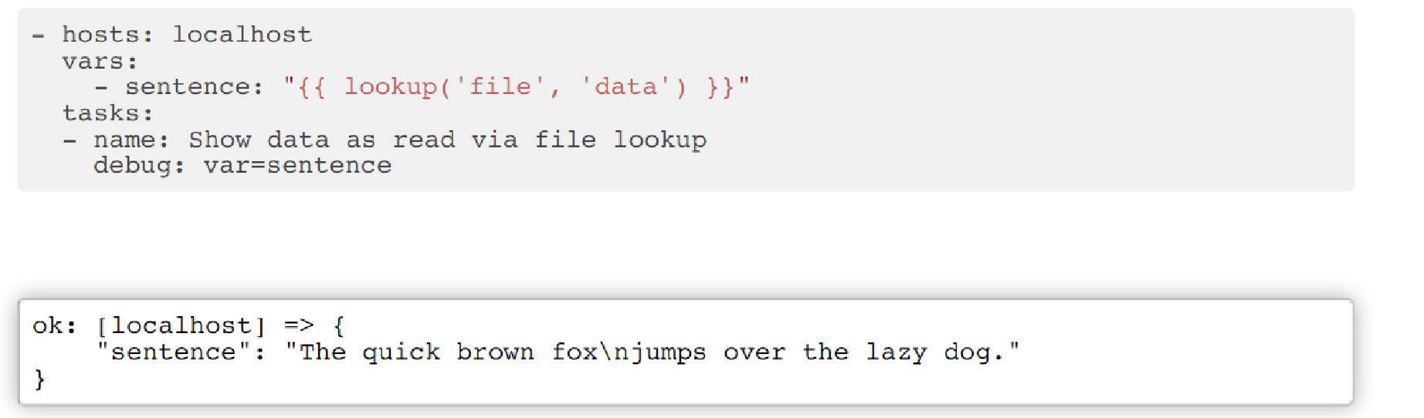
File lookup

Slide 198
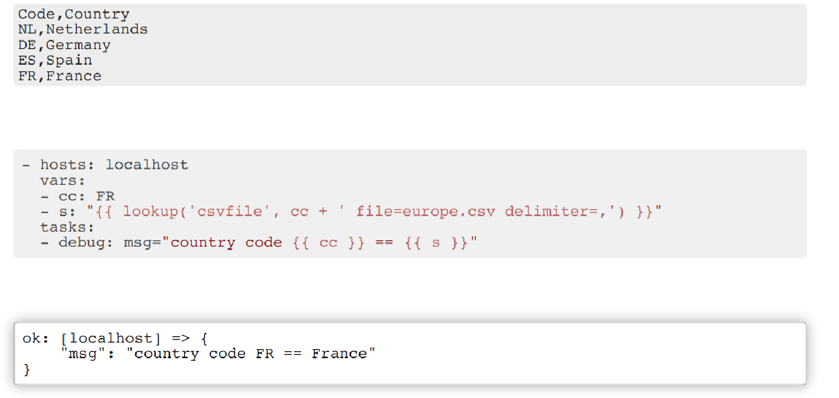
Csv lookup

Slide 199
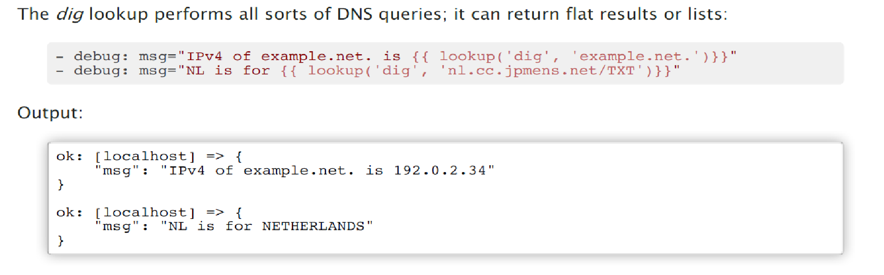
Dns lookup

Slide 200
What we have covered
Inclusion of external files.
Lookups and joins with any element.

Slide 201
Best practices

Slide 202
Plan
Consider Ansible as a programming language
Automate with style
Integration with Git
Choice of hostnames
Host grouping
Variable naming
Location of variables
Make your playbook readable
Ensure proper execution
Using the right tools
Good use of roles
Running as root
Properly debug your code
Ansible Tower best practices

Slide 203
Consider Ansible as a programming language
Automation is a development language.
Control of Ansible content
Iterate:
Start with a basic playbook and static inventory.
Organize and modularize the code.

Slide 204
Automate with style
Create a style guide to ensure code relevance:
Tagging
Naming of tasks, plays, variables et rôles.
Folder structure.

Slide 205
Automate with style
site.yml webservers.yml deployonce.yml
inventories/
production/
hosts
group_vars/
host_vars/
london/
roles/
requirements.yml
common/
webtier/
# Main playbook calling others
Playbook pour l’équipe webserver
# separate playbook to run once
# different levels of inventories
# Production team inventory
# Grouping of if necessary
#Include external roles
‹#›

Slide 206
Integration with Git
Start by putting everything in one repository.
Long term:
A git repository per role.
Repository for each team.

Slide 207
Choice of hostnames
Naming hosts with meaning rather than using IP or DNS addresses
10.1.2.75
10.1.5.45
10.1.4.5
10.1.0.40
db1 ansible_host=10.1.2.75 db2 ansible_host=10.1.5.45 db3 ansible_host=10.1.4.5 db4 ansible_host=10.1.0.40
w14301.acme.com w17802.acme.com w19203.acme.com w19304.acme.com
web1 ansible_host=w14301.acme.com web2 ansible_host=w17802.acme.com web3 ansible_host=w19203.acme.com web4 ansible_host=w19203.acme.com

Slide 208
Host grouping
Group your hosts for easier inventory selection and fewer conditional tasks.
The more groups, the better.
[db] | [east] | [dev]
db[1:4] | db1 | db1
 | web1 | web1
[web] | db3
web[1:4] | web3 | [testing]
db3 web3
[west] db2 web2 db4 web4
[prod] db2 web2 db4 web4

Slide 209
Naming variables
Clear variable names allow better readability and clarity of plays.
Avoid collisions by adding prefixes.
a: 25
data: ab data2: abc id: 123
apache_max_keepalive: 25
apache_port: 80
tomcat_port: 8080

Slide 210
Location of variables
Locate the appropriate location for your variables based on their nature and when they were defined.
Separate tasks from variables and reduce repetitions.

Slide 211
Make your playbook readable
No
name: install telegraf
yum: name=telegraf-{{ telegraf_version }} state=present update_cache=yes notify: restart telegraf
name: start telegraf
service: name=telegraf state=started

Slide 212
Better, but no
Make your playbook readable
- name: install telegraf yum: >
name=telegraf-{{ telegraf_version }} state=present
update_cache=yes enablerepo=telegraf
notify: restart telegraf
- name: start telegraf
service: name=telegraf state=started

Slide 213
Correct
Make your playbook readable
- name: install telegraf yum:
name: “telegraf-{{ telegraf_version }}” state: present
update_cache: yes enablerepo: telegraf
notify: restart telegraf
- name: start telegraf service:
name: telegraf state: started

Slide 214
Ensure proper execution
Use command-line ansible options for better interaction and debugging.
-vvvv
--step
--check
--diff
--start-at-task
--list-tasks
--list-tags
--list-hosts
--syntax-check

Slide 215
Ensure proper execution
Avoid inventories if not necessary.
For a single task, use the comma:
ansible all –i neon.qxyz.de, -m service -a "name=redhat state=present"
For playbooks too, use the comma:
ansible-playbook -i neon.qxyz.de, site.yml

Slide 216
using the right tools
Avoid the command module as much as possible.
Use an existing Ansible module.
name: add user
command: useradd appuser
name: install apache command: yum install httpd
name: start apache shell: |
service httpd start && chkconfig httpd on
- name: add user
user:
name: appuser
state: present
- name: install apache
yum:
name: httpd
state: latest
name: start apache
service:
name: httpd
state: started
enabled: yes

Slide 217
Good usage of roles
Create roles for each team and object.
Save roles to git repositories.
Import roles using Ansible Galaxy.
Download roles from Galaxy and adapt them well to your needs.

Slide 218
Running as root
Ansible runs as root.
For security purposes, root access is not possible.
Use the become method to run via sudo.
Best solution: create a dedicated Ansible user

Slide 219
Properly debug your code
Keep the automated code files on the remote machine:
$ ANSIBLE_KEEP_REMOTE_FILES=1 ansible target-node -m yum
-a "name=httpd state=absent"

Slide 220
What we have covered
Good practices for using Ansible.
Tips for use in business and practice.

Slide 221
Conclusion

Slide 222
objectives
Understand the organization of Ansible (roles, tasks, playbooks, modules...)
Install and configure Ansible
Use and create playbooks to manage an infrastructure

Slide 223
The training plan
Introduction to Ansible
SSH Secure Tunelling
Ansible Basics
Inventory file
Ad-hoc Orders
Yaml language
Playbook
Variables
Control structures
Tagging: Tags
The roles
Ansible Vault
Lookups
Best practices
6

Slide 224

Thank You ☺

